Slide 1

RAY LEMIEUX
TRAINING SPECIALIST-WELDING
UA CANADA

Slide 2
PRESSURE WELDING IN CANADA
INDUSTRY CHALLENGES
WHAT UA CANADA’S IS DOING
SOLUTIONS TO IMPROVE OUR CURRENT SITUATION
CONSIDERATION OF PROPOSED CHANGES TO PROVINCIAL REGULATIONS
REGISTRATION OF UA WELDING PROCEDURES FOR DEVELOPMENT PROCESS & PERFORMANCE QUALIFICATIONS

Slide 3
UA CANADA WELDING PROGRAM MANDATE
ADDRESS INDUSTRY CHALLENGES
WORK WITH INDUSTRY PARTNERS
STANDARDIZED WELDER PROGRAMS/EXPECTATIONS
CERTIFICATIONS/MOBILITY
Notes:
Industry Challenges Slide #4
Industry Partners, Manufacturers(Lincoln, Miller) Contactors, Clients, and Authorization Having Jurisdiction (AHJ’s)
Standardized Welder Programs- Apprentice Development, Journeyman Upgrading, Training Centre Welding Program Assessments.
Working with Business Development Reps to ensure information and selection of future welding members meet our standard.

Slide 4
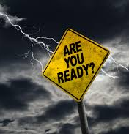
INDUSTRY CHALLENGES
Shortage of Welders
Aging workforce
Differences in welders' skills and abilities
High repair rates
Unknown of TFW Skills
Trust factors from other jurisdictions
Current model needs to improve to stay competitive in a more global market

Slide 5

INDUSTRY PARTNERS
AHJ’S- AUTHORITY HAVING JURISDICTION
ACTIMS
IRVING OIL/SHELL
BRUCE POWER-OPG
CPFA- CANADIAN PIPE FABRICATORS ASSOCIATION
SKILLS CANADA
RED SEAL
CWB-CANADIAN WELDING BUREAU
MANUFACTURERS

Slide 6

CURRENT MODEL
Rules and Regulations
Apprenticeships
Training Center Capabilities- Assessing, Training & Testing
Membership Attitudes
Notes:
Not one province has the same rules and regulations with regards to pressure piping. Many variances with regards to when a welder can take a qualification test.
BC- new proposed changes forth coming – IT designation (pressure welder in training)
Alberta –Compulsory trade, Apprenticeship and Red Seal or provincial journeyman certificate for Alberta B designation can apply for c-level after a certain amount of time
SASK - Journeyperson certificate or 5400 documented hours prior – this system does not help the pressure welding industry
Manitoba - Journeyperson certificate or 4800 documented hours prior
Ontario – no restrictions creating a system without expectations*
Quebec – system does not favour the pressure piping industry
New Brunswick – utilizes a license system
Nova Scotia – Journeyman Status or Red Seal or 2 years experience of open root welding
NFLD- Must have a Red Seal-Prior
Yukon – Journeyman of 36 months experience
NWT – journeyman cert plus 12 months of practical experience
Nunavut- info not provided

Slide 7
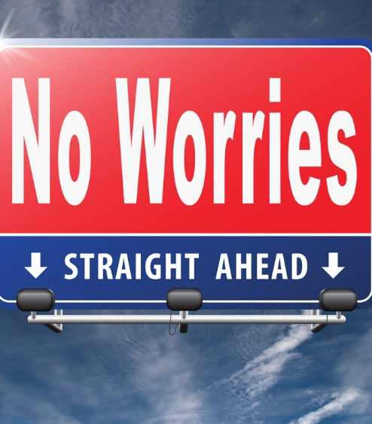
RQ 4 TRAINING
PLANNING FOR THE FUTURE

Slide 8
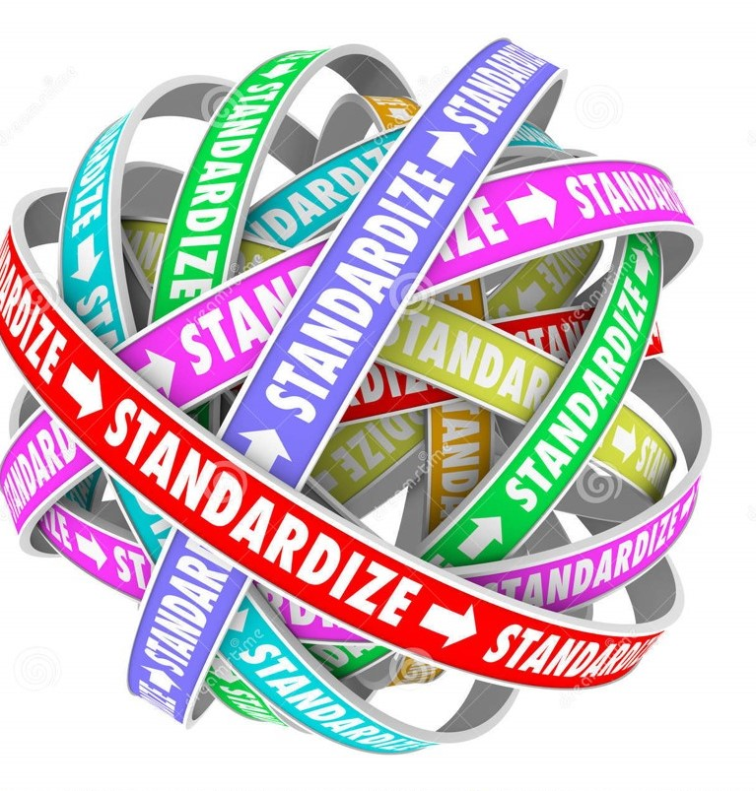
Standardized Model For The UA Welder in Canada
PILOT PROGRAM – R.E.W.A.R.D
STANDARDIZED CURRICULUM –CWBi ACORN
STANDARDIZED EXPECTATIONS
END GOAL –UA JOURNEYMAN PRESSURE PIPE WELDER
Notes:
As part of my main

Slide 9
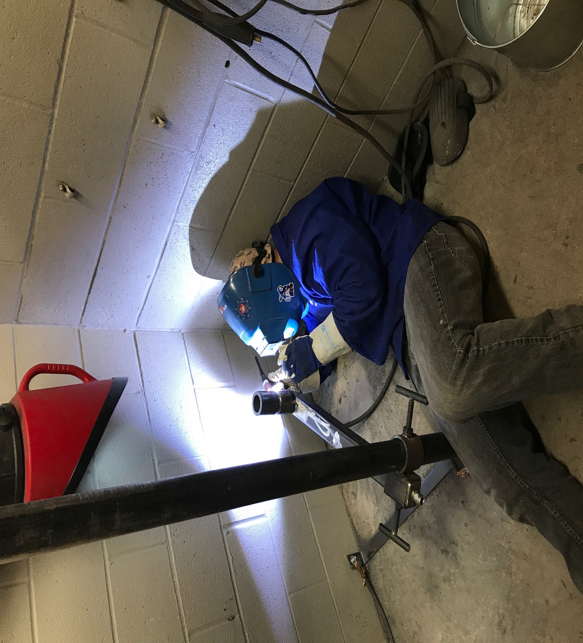
UA Welder Apprentice Development Model Program
Regional
Education for
Welder
Apprentice
Retention &
Development
Notes:
Pilot program in NB UA Local 213
Candidates were given Interview, aptitude tests and had to meet the basic level of completion of Level 1 Trade School, plus approximately 1 year experience which may be through the community colleges or private schools
Practical qualifications are minimum All Position Plate with F4 electrode CWB W47.1
F3/F4 Approved ticket- Minimum Year 1 pre-requisite plus passing of Block 1 exam.
Restricted to only welding on systems under 160psi pressure piping and any requirements that utilize CSA W47.1 Standard for F4 all position plate. CWB credentials.
Year 2- upon completion of year 1 hours will attend and pass Level 2 block and have the ability to test/pass the F3/F4 qualified license which then remove the 160PSI pressure piping restriction .
Upon passing of the F3/F4 Qualified license apprentices will then be allowed to progress and have the opportunity to test for other Specialty Licenses and welding processes like GTAW, GMAW, FCAW and if required SAW.
Upon completion of Level 2 hours apprentices will attend Level 3 block and upon successful passing will then move into 3 year.
Years 2 and 3 Apprentices continue to hone skills and develop the needed piping skills to weld what ever could be asked of them in the pressure welding field
Upon completion of 3rd year hours apprentices will be required to write and pass the Red Seal exam upon passing all practical requirements for the Province of New Brunswick for this trade.
Upon receiving Red Seal Apprentices will then be moved into Journeyman Class.

Slide 10

Red Seal Training Program
Continue to support the Red Seal Program
Harmonization has created new Standards
Practical element as of 2017

Slide 11

Partnerships- Theory

Slide 12
Standardized Curriculum
CWBI Acorn/Licensing Agreement-signed
Provide Co-Branding Opportunities
Instructional material for Pre-Apprentice/Foundations – Welder and Metal Trade
All 3 levels of curriculum complete.
Instructor and student resources available.
In-school and online material utilized
Journeyman Upgrader courses along with Red Seal online

Slide 13
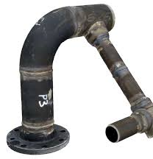
Pressure Systems Assessment Assembly
What is Involved?
Theory Assessment- Online
Practical Assessment-In Shop
Assessment is based upon Written, Practical, Material Handling, Cutting, Appearance, and Observation
Notes:
Written- Grasp of theory
Practical- Use of Tools, demonstration of key welding skills
Material handling skills
Cutting and shaping skills
Appearance- Quality of workmanship
Observation- In shop behavior, safety, etc.

Slide 14
Success Factors-Committed to Excellence
Proactive
Creating Benchmarks
Business Reps will have more success with recruitment
Standardization takes Provincial regulations out of Play
Provide high quality, high pressure specialty welders at the end of the process that can deliver on skills and productivity
UA Welder will continue to lead the way in the industry

Slide 15

MEMBERSHIP ATTITUDES
Notes:
Can’t change the past must continue to move forward in a positive manner--- EXPECTATIONS

Slide 16
A UA HIGH PRESSURE JOURNEYMAN WELDER IS!
Is a tradesperson who has satisfactorily completed an apprenticeship, or an equivalent amount of time in the welding field as a pressure welder.
Is Capable of Welding X-Ray quality open root pipe and fittings as well complete fillets on appropriate pipe supports and hangers. With less than a 1% failure rate
Utilize the following SMAW, GTAW, GMAW and when required the SAW Process
Carry Both ASME and CWB Credentials

Slide 17

Harmonization of High-Pressure Welding Certifications- Support Groups
UA CANADA –NAUSC
UA INTERNATIONAL –WELD CERT PROGRAM ENDORSED BY THE NCPWB
Provincial Registration
Owners and Clients.
MCAC
Provincial MCA’s
Zone affiliate’s
Notes:
The Harmonization of High-Pressure Welding Certifications –Support Groups
For this initiative to move forward we will be looking at our contractor partners for support of this program along with Owners and Clients with approval of Provincial Regulatory Bodies (AHJ)
Review current testing requirements and incorporate a more streamlined testing procedures available under ASME IX, to meet desired outcomes.

Slide 18
THANK YOU

